Slide 1
Knowledge Management Academy

Slide 2



Slide 3
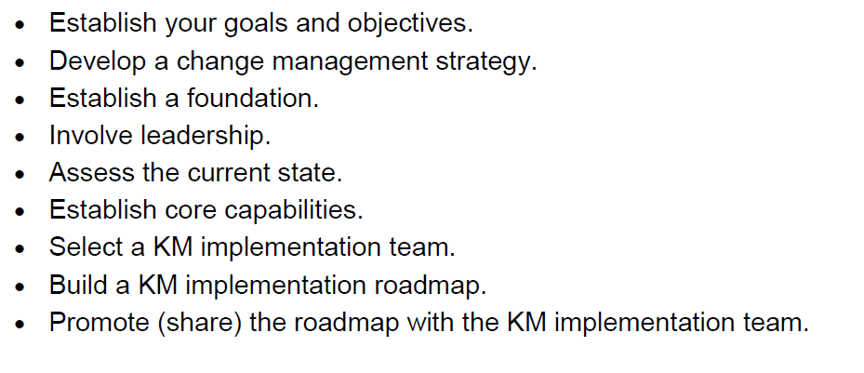
IMPLEMENTATION PLAN Knowledge Management Academy

Slide 4
Identifying need - Establish goals and objectives
Identifying need - Establish goals and objectives
Currently - key man reliance across all teams
Disconnect between teams- dev teams and support
Why is there reluctance with devs to be on standby?
Retention of staff
Short term goals
Creating a culture of sharing knowledge
Upskilling team members - eliminate key man reliance
Progression path - career goals - Help team members progress from graduate to devs, etc.
Long term goals
No key man reliance
Motivated team members
Effective work saving time and quicker turnaround time

Slide 5
Change Management Strategy
Introduce a leadership programme - pairing with key team members in each space
Implementation team- identify big brother pairing
Help team members understand the need for a Knowledge management system - get their buy in by building our retention strategy.
Encourage knowledge sharing behaviour.
Supports performance appraisals and KPIs for the big brother as well
Incentivise knowledge sharing

Slide 6
Establish a Foundation
Created - part of the academy process , create the documentation that you were taught- against the ticket (Ado) and training internally with team members and extended to dev support
Categorised - documented per project/ product/ requirement on ADO
Shared - education sessions, video recording, internally with team members

Slide 7
Involve Leadership
Weekly catchup session with the senior leadership team providing feedback
Encourage team members to accept the changes that its likely to bring by involving in the big brother participation academy

Slide 8
Assess the current State
Culture - creating a culture of learning, upskilling
Structure -
People - Nurturing growth
Processes - the big brother Knowledge management academy
Technology – ADO /Azure

Slide 9
Establish Core Capabilities
Ease of capturing knowledge - journal, tickets
Syndication of knowledge for easy access - WIKI on ADO
Available feedback mechanisms - final interview. During duration of programme, regular bi- monthly sessions tied in with the sprints to discuss progress and status.
Performance measurements and reviews- tied in with feedback and performance appraisals, career roadmap (promotional framework). Burndown charts on ADO
Added intelligence - Automatic flow of pull requests. As tickets get updated, emails are sent

Slide 10
Select an implementation team - SDLC cycle
The key man reliance team member - could be from dev space, BA, QA, DBA and dev Support
The graduate/ junior
The team lead
Tech lead
Team coordinator to ensure updates going forward
Based on projects or Knowledge Management Academy
Skills and representation covered by implementation team and big brother academy
Roles covered by the implementation team

Slide 11
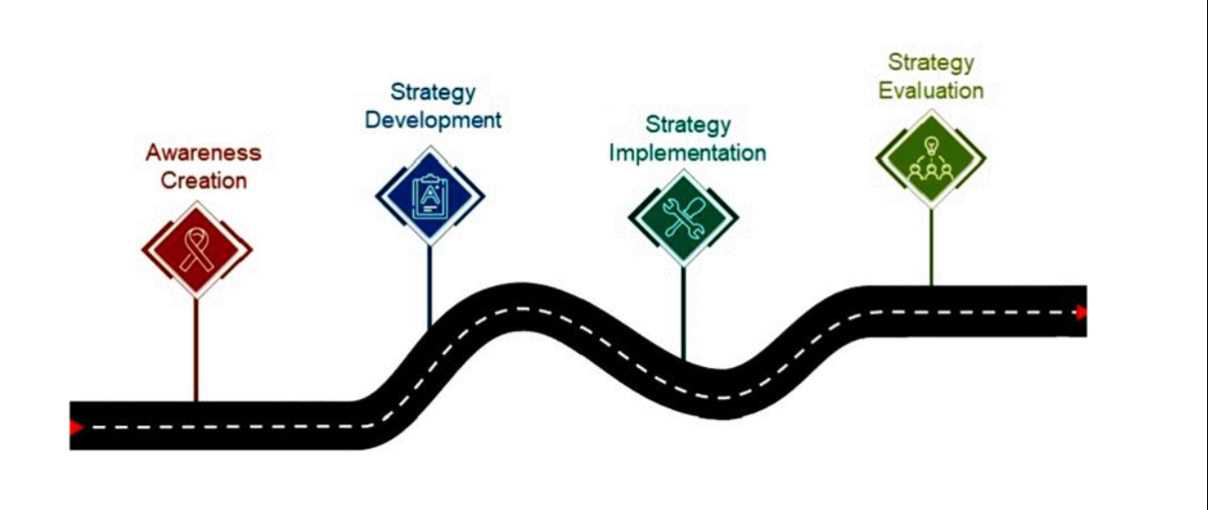
Build an implementation roadmap
The key man reliance team member - could be from dev space, BA, QA, DBA and dev Support
The graduate/ junior
The team lead
Tech lead
Team coordinator to ensure updates going forward
Based on projects or Knowledge Management Academy
Skills and representation covered by implementation team and big brother academy
Roles covered by the implementation team

Slide 12
Putting the plan in action…
Continue to review
Learn lessons
Assess the effectiveness of the academy
Make improvements

